Slide 1

Excel Final Assessment
Submitted by :- Arpit Goyal
Employee Id - 4264

Slide 2
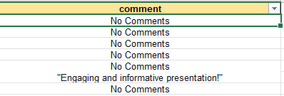


Q1
1)The Data was given sorted using comments disabled.
So Firstly I have unsorted the Data to check the dulicates or blanks
3) As you can see the blanks aare filled and the data is now in the appropriate formats .
2)After the unsorting to check the blank values I have used the ctrl + g function and selected all the blanks in comments and then filled the blanks with the “No Comments “

Slide 3



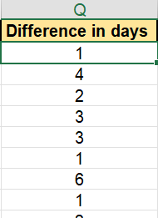

Q2
1)Created a column for the time difference in days
2)Used the formula of simple substraction
= trending_date -publish_date
3)As you can see the column has been created with the time difference in days .
4) Average has been calculated using the time difference column .
Formula used is
=AVERAGE(Q2:Q16308)
5)Using this formula the answer we got is
The Average time gap the video takes from publishing date to trending date is 2.298154167

Slide 4

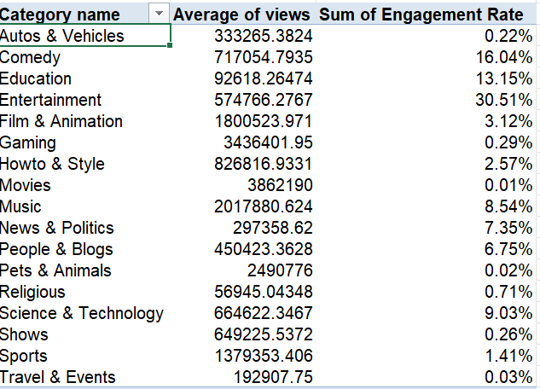



Q3
1)To do this question we created these 2 columns from our data .
2)The engagement rate was calculate using simple arithemetics
= (likes + comments_count)/ views
Where as the Category data was calculated using the formula
=XLOOKUP(E2,Category!$A:$A,Category!$B:$B)
3)Now Using the 2 columns which we have created in the data .
We have created a pivot table .
4) As you can see the picture above the Average views per category is calculated .
With the engagement rate .

Slide 5

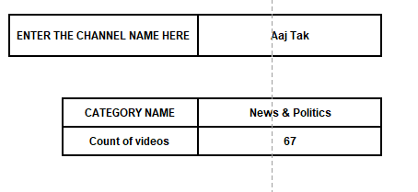
1)Created the proper format for the marketing team to c=just type the channel name and the details will be shown like the images below as you can see.
Q4
2) In the channel name we have use the data validation and we have made a dropdown list of all the channel so that anyone can find out the details
3)For the category name we have used the formula
=XLOOKUP(XLOOKUP(I7,'YouTube data'!$D$2:$D$16308,'YouTube data'!$E$2:$E$16308,,0),Category!$A$2:$A$33,Category!B2:B33,,0)
for the count of videos we have used this formula
=COUNTIF('YouTube data'!D:D,I7)

Slide 6



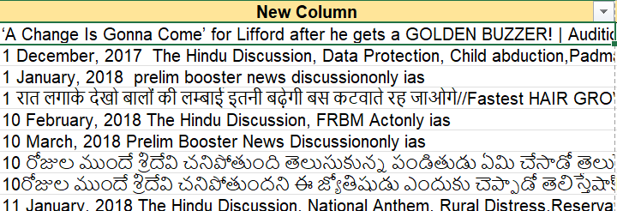
1)Used CONCAT Ftn to concatenate the title and channel title and created a column named New Column using the formula =CONCAT($A7,$B7) As you can see in the below image the strings are concatenated .
Q5
3)Well then for the 2nd task I have just sort the data for comments which are available and left the “no comments videos” as you can see in the image below .
4) Then I have created a new column called “combining comments” and used the formula
=TEXTJOIN("##",TRUE,D2:D593)
U can see the picture containg the combining comments column for reference.

Slide 7
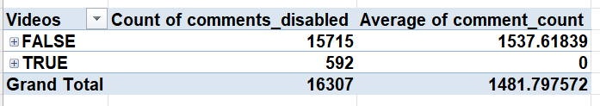
1)As you can see we have calculated the data using pivot table 2) the Average numbet of comments for each group are Comments Enabled – 1537 Comments Disabled – 0 2)As we can see that the comparison of comments on both the categories are very clear.
Q6

Slide 8
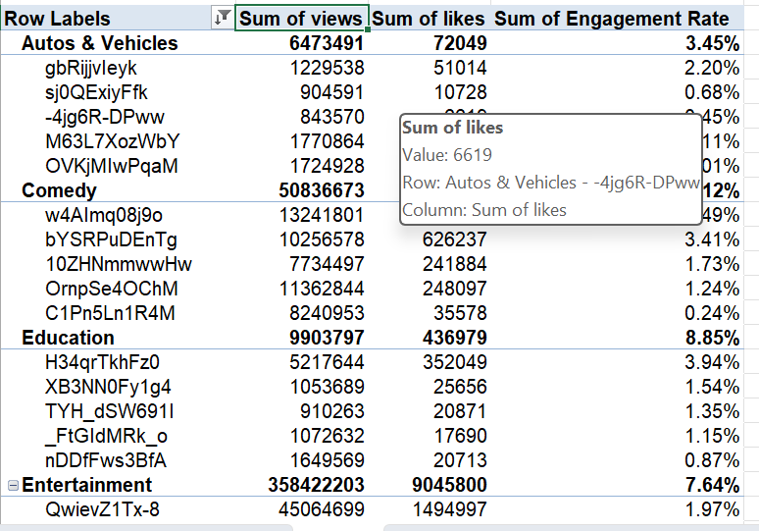
Q8
1)Sorted the videos on the based of views and likes and engagement rate .
2) Each category’s top’5 videos are shown .

Slide 9
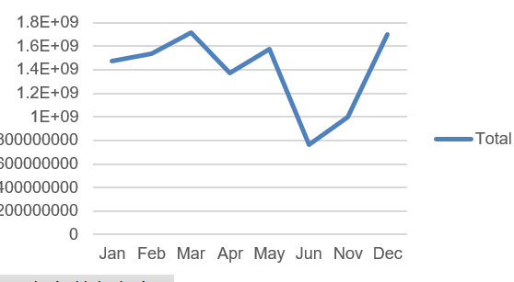
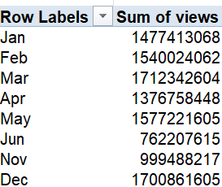
1) Filtered Videos Based On Publish date and views count and grouped those date into months .
2)Obtained this graph in which it can be clearly seen that initially the videos views went up W.r.t publish dates and in the middle(June-nov) the vies declined thoroughly.

